Slide 1

Exploring Lending Club Loan Default Rates
Lujain Alqassar
Cordell Williams
Deniz Ipek Ozakyol
Sihoon (Daniel) Yu
Yongxian (Caroline) Lun

Slide 2
Background Information
Objective
Lending Club (LC) is a firm that offers members a broad range of financial instruments to achieve their goals.
The primary LC products are personal loans that range from $500 to $40,000.
The dataset is a sample of 780k peer-to-peer personal loans between 2013 and 2020.
Exploring loan distribution and how different loan and borrower characteristics impact the likelihood of default on a personal loan.
Notes:
Cordell

Slide 3


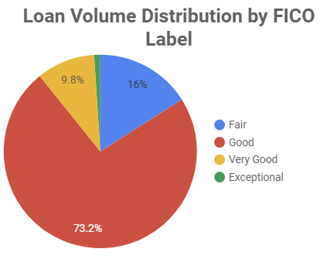
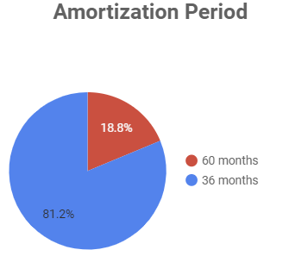
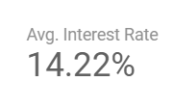

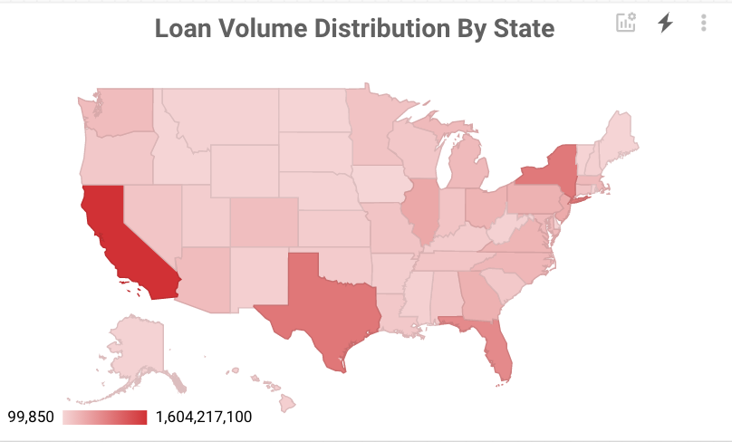
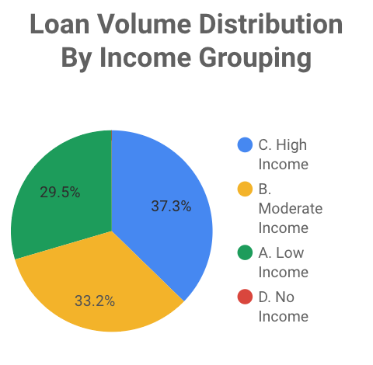
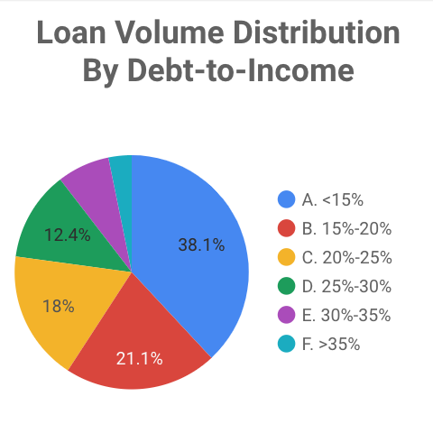
Summary of the Dataset
Notes:
Cordell

Slide 4
Features of Interest
Loan Amount Range
Income Group
Loan Purpose
FICO Rating
Variables We Evaluated
State
DTI Ratio
Home Ownership
Borrower Count
Employment Length
Amortization Period
Notes:
Darker boxes indicate the ones we deemed were more impactful.
Deniz

Slide 5
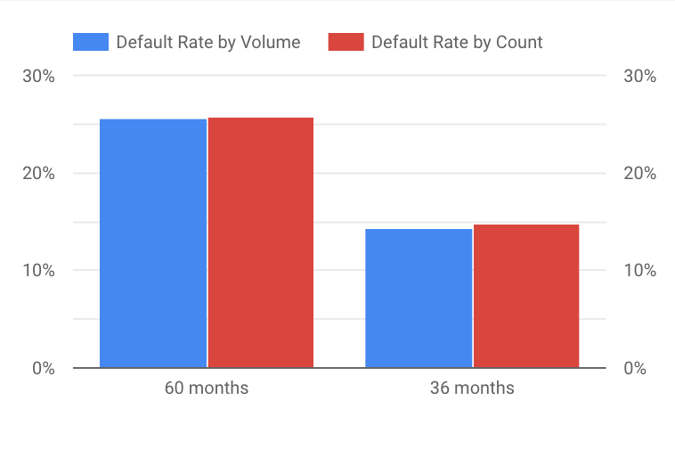
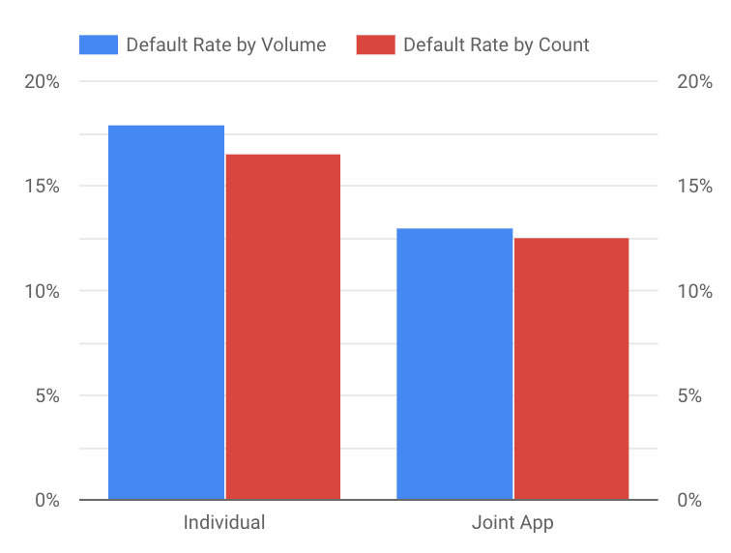
Amortization Period & Borrower Count and Default Rate
Borrower Count:
Individual borrowers default more than joint borrowers.
Individual → 16%
Joint → 12.5%
Amortization Period:
Loan borrowers who have an amortization period of 60 months are more likely to default than those of 36 months.
60 months → 25%
36 months → 15%
Notes:
Deniz

Slide 6
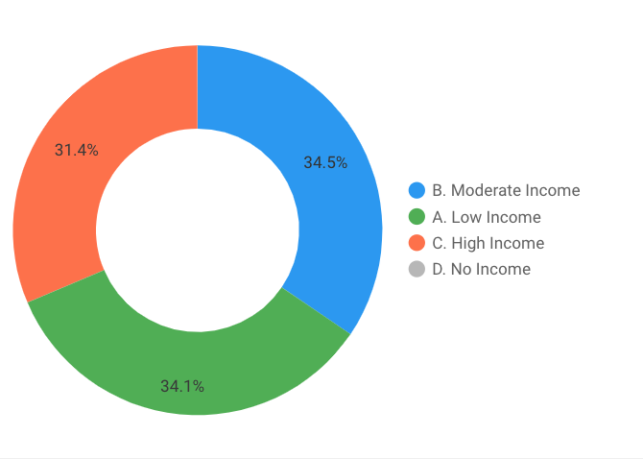
Income Group and Default Distribution
From all loans that defaulted, 34.5% were moderate income, 34.1% were low income, and 31.4% were high income.
Income Group | Total Counts (Thousands)
A. Low Income | 231.754
B. Moderate Income | 260.505
C. High Income | 292.864
D. No Income | 0.339
Notes:
Daniel

Slide 7
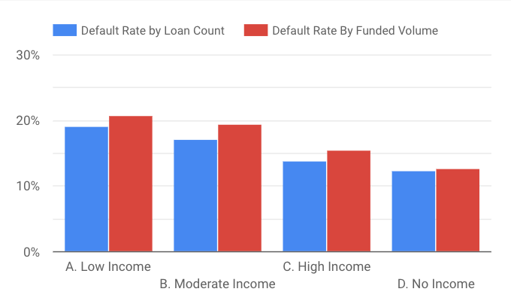
Income Group and Default Rate
The lower the income, the higher the default rate.
Relationship to Interest Rate
Income Group | Average Interest Rate
A. Low Income | 0.1477
B. Moderate Income | 0.1451
C. High Income | 0.1383
D. No Income | 0.156
Notes:
Daniel

Slide 8
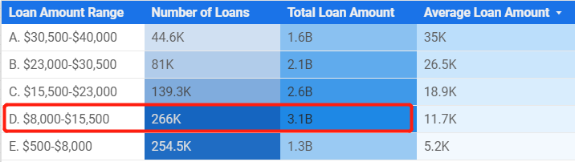
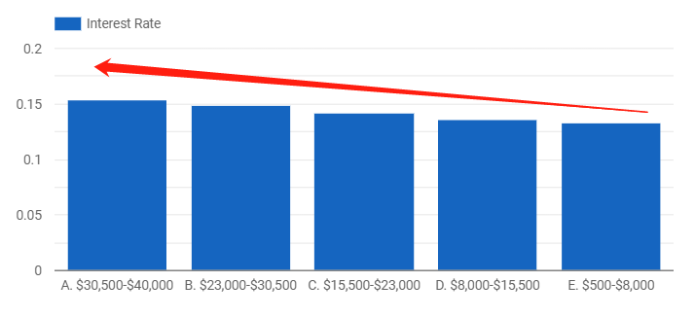
Financial Characteristics of Loan Amount Range
Loan amount ranging from $8,000 to $15,500 is the most popular personal loan.
Loan Amount Interest Rate
Notes:
Caroline

Slide 9
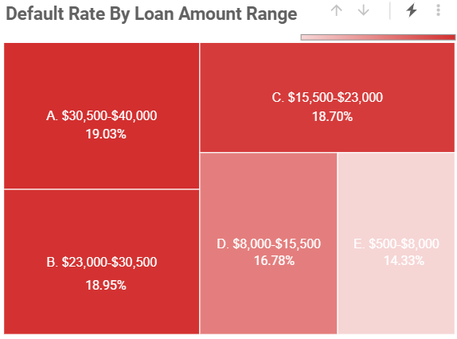
Loan Amount and Default Rate
The larger the amount of loan lended out , the higher the risks will be for the borrower to default on their account.
Loan Amount Default Rate
Notes:
Caroline

Slide 10
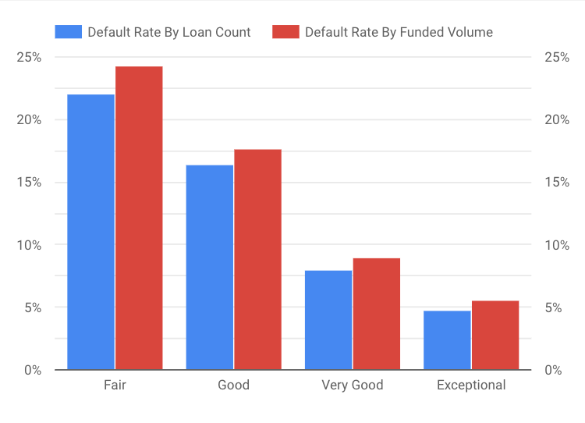
FICO Score and Default Rate
Used credit rating to determine FICO rating from credit score.
Not surprisingly, loan borrowers with ‘Very Good’ and ‘Exceptional’ credit scores have less than 10% chance of defaulting.
‘Fair’ and ‘Good’ ratings have over 15% of defaulting
Notes:
Lujain
FICO Rating:
Fair: 580-669
Good: 670-739
Very Good: 740-799
Exceptional: 800-850
Handle their credit better because they pay bills on time

Slide 11
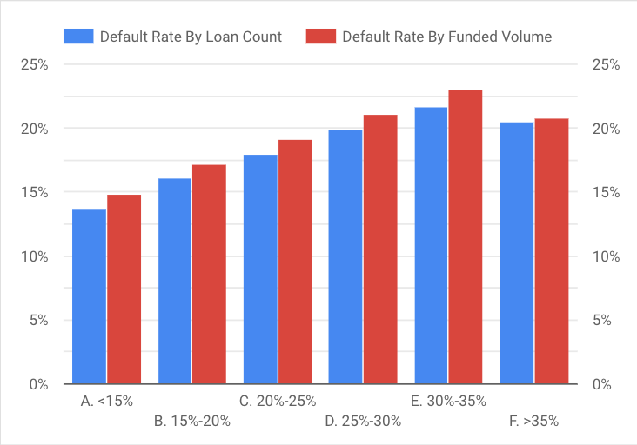
Debt-to-Income Ratio and Default Rate
Default rate increases with higher debt-to-income ratios.
DTI <15% → Default rate of 13%
DTI 30-35% → Default rate of 23%
Surprisingly, default rate decreases slightly for those with over 35% DTI ratio.
Notes:
Lujain
Why would over 35% dti have a leser default rate? It could be because many of the people with high incomes have higher dti could be for home improvement or business operations (while loan purpose for lower incomes would be for necessaities, it doesnt necessarily mean that they are in high risk of default because purpose would be different and for a short period of time. It only accounts for a small percentage of people who want to leverage their capital for small businesses or something similar.
More exploration is needed on the dataset.

Slide 12
Machine Learning Model

Slide 13
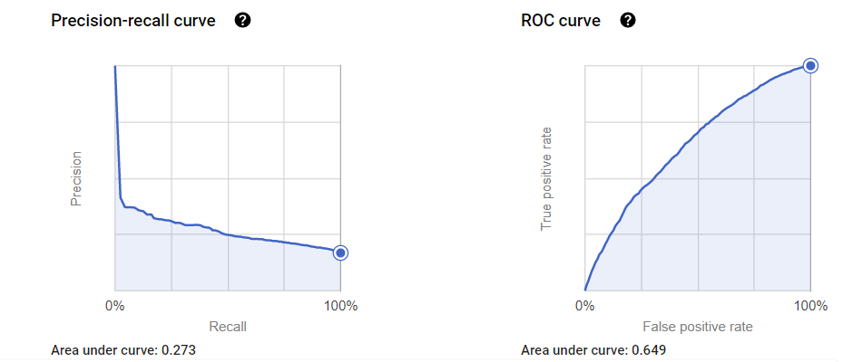
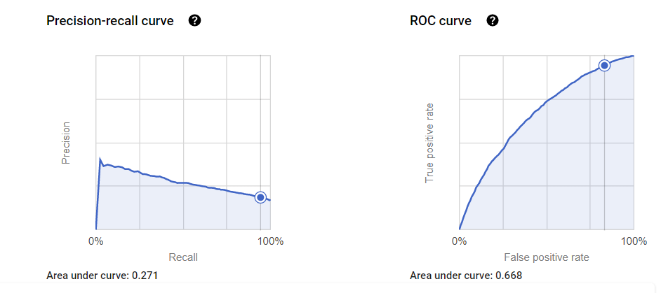
Logistic Regression Machine Learning Model → Will the loan borrower default or not?
Classification Model 1:
Labels: “Current”, “Default”
Features: FICO, DTI, income group, loan amount, amortization, application type, loan purpose
ROC AUC: 64.91%
At threshold of 10.32%, model predicts default rate of 85.8% (16.5% actual) with 94% true-positives
Classification Model 2:
Labels: “Current”, “Default”
Features: FICO, DTI, annual income, loan amount, amortization, application type, loan purpose, state, delinquent_2yrs
Removed incomes > $500K
ROC AUC: 66.76%
At threshold of 10.32%, model predicts default rate of 85.27% (16.5% actual) with 94.2% true-positives

Slide 14
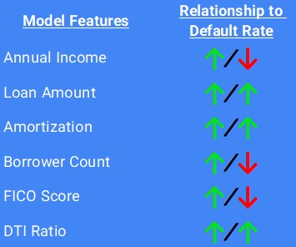
Conclusion
Based upon our data analysis, we would recommend that Lending Club either not provide funding for the the riskiest of loans (such as borrowers with low-FICOs, low-income, high-DTI, high-loan amounts), or appropriately price the loans based on a multi-dimensional scale.
Notes:
Lujain
Questions regarding the conclusion will be answered by Cordell
Appropriately pricing the loans → interest rate for the loan
Multi-dimensional scale → not necessarily all features need to be related (i.e. low-income, high loan amount, but high fico and low dti)
Does not make sense to not give out loans because they do not meet all the criterias

Slide 15
Thank You!
Any questions?

